Slide 1
UNIT - III
Chapter – 5
Thermal Engineering 2:
Thermal Systems Applications

Slide 2
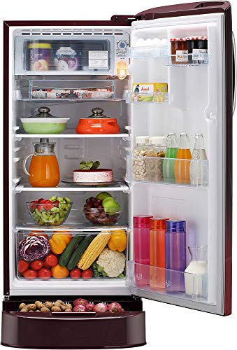
Thermal Systems Applications
Refrigeration system
Air conditioning system
Pumps
Blowers, and
Compressors

Slide 3
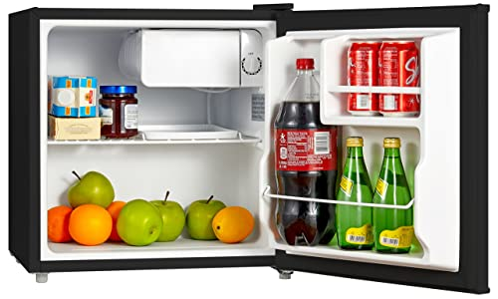
Session – 1
Contents:
Introduction to refrigeration system
Parts of Refrigerator
Vapor Compression Refrigerator
Vapor Absorption Refrigerator
Comparison between Vapour Compression and Absorption systems
Properties of good refrigerant
Performance characteristics of a refrigeration system
Air Conditioning system

Slide 4
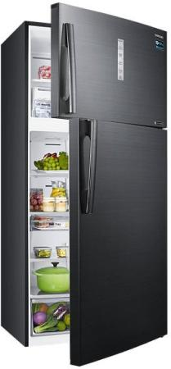
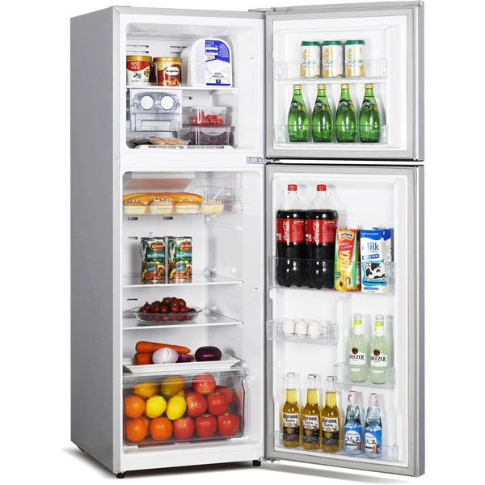
Refrigeration system

Slide 5
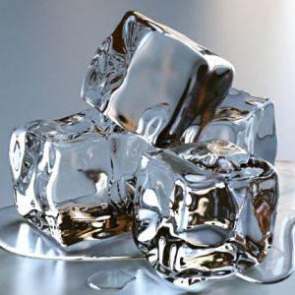
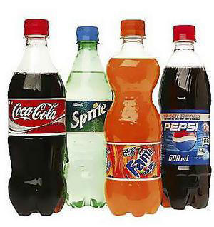
Refrigeration system
Introduction:
It is an art of Artificial cooling employed in,
Ice making
Cold storage
Preservation of the
perishables such as, → Milk
→ Vegetables / Food
→ Drinks
→ Medicines, etc.

Slide 6
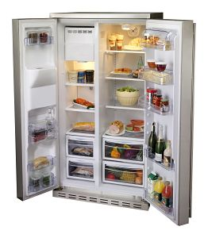
Refrigeration system
Definition:
Refrigeration is defined as a method of reducing the temperature of a system below that of the surroundings, and
→ maintain it at the lower temperature by continuously abstracting the heat from it.

Slide 7
Refrigeration system
Parts of a Refrigerator:
Evaporator
Compressor or Pump
Condenser
Expansion device

Slide 8
Terminologies used in Refrigeration system
Refrigerating effect:
It is the rate at which the heat is absorbed in a cycle from the space to be cooled.
Ton of Refrigeration:
It is defined as the quantity of heat absorbed in order to form 1 ton of ice in 24 hours, when the initial temperature of water is 0⁰ C.
Water at 0⁰ C 24 Hours 1 Ton of Ice
(Initial state) Heat absorption (Final state)

Slide 9
Terminologies used in Refrigeration system
Coefficient of performance (COP):
Performance of a Refrigerator system is expressed by COP.
It is defined as the ratio of heat absorbed in a system to the work supplied.
COP = Heat absorbed
Work supplied

Slide 10
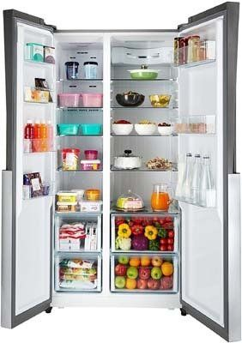
Refrigeration system
Types of a Refrigeration systems:
Vapour Compression Refrigerator
Vapour Absorption Refrigerator

Slide 11
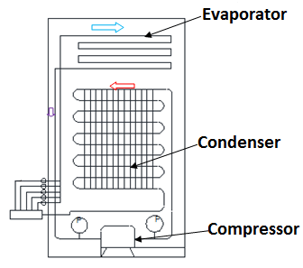
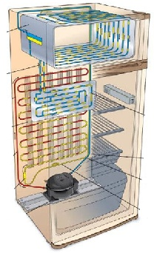
1. Vapour Compression Refrigerator
Domestic Refrigerator

Slide 12
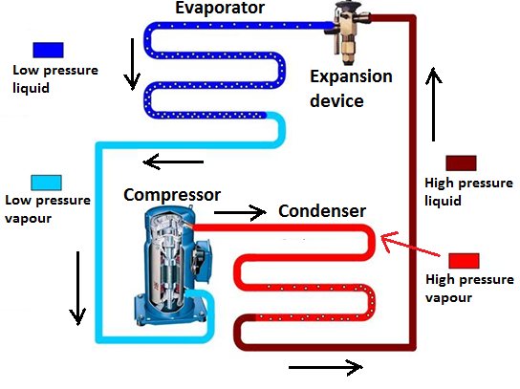
1. Vapour Compression Refrigerator

Slide 13
1. Vapour Compression Refrigerator
Refrigerant:
Working fluid.
Ex: Ammonia, Freon, Methyl chloride, CO₂.
Circulated in the refrigeration system.
During evaporation,
Absorbs latent heat from the space.
Liquid becomes vapour.
During condensing,
Gives off heat to the surroundings.
Vapour becomes liquid.

Slide 14
1. Vapour Compression Refrigerator
Evaporator:
Made of coiled metal tubes.
Placed in freezing compartment.
One end is connected to the suction end of the compressor.
Other end is connected to expansion (throttle) valve.

Slide 15
1. Vapour Compression Refrigerator
Evaporator:
Liquid refrigerant at low pressure & low temperature,
→ enters the evaporator.
Absorbs heat from the contents in the freezing compartment.
Refrigerant evaporates & lowers the temperature of the space.

Slide 16
1. Vapour Compression Refrigerator
Compressor:
A mechanical device.
Driven by an electric motor.
Used to circulate the Refrigerant, in the system.
Draws the low pressure vapours from evaporator.

Slide 17
1. Vapour Compression Refrigerator
Compressor:
Compress them to high pressure & high temperature.
Sends dry refrigerant vapours at high pressure to condenser.

Slide 18
1. Vapour Compression Refrigerator
Condenser:
High pressure & high temperature refrigerant vapour gives off latent heat to the atmosphere.
(Heat flows from high to low level).
Condenses in to liquid, due to heat rejection.(Temp. lowers).
High pressure condensed liquid refrigerant at room temp (approx) flows to the throttle valve.

Slide 19
1. Vapour Compression Refrigerator
Expansion device (throttle valve):
High pressure liquid refrigerant, expands to low pressure & low temperature.
→ Causes the refrigerant to evaporate partly.
Refrigerant coming out of this valve, will be
→ Wet vapour with low temp. (around -10⁰ C).
Refrigerant then passes through the Evaporator. Cycle repeats.
Thermostat is used to maintain the required temp. in the Refrigerator.

Slide 20
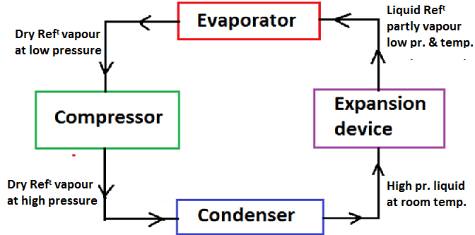
1. Vapour Compression Refrigerator

Slide 21
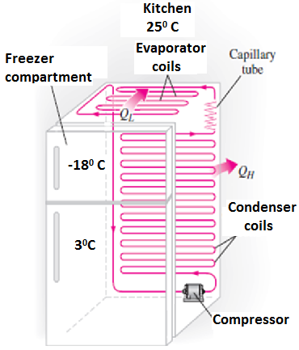
1. Vapour Compression Refrigerator
Condenser
Evaporator

Slide 22
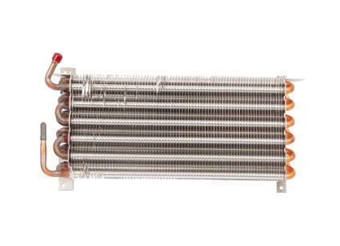
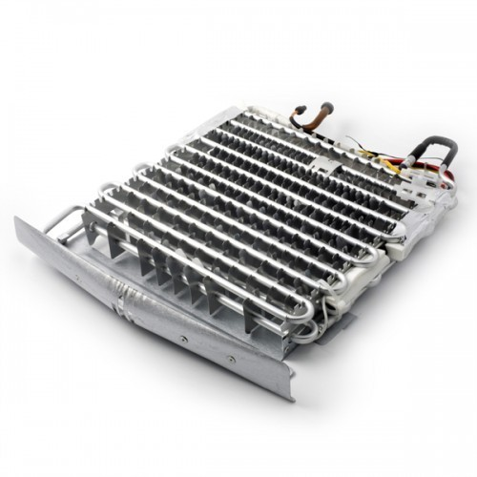
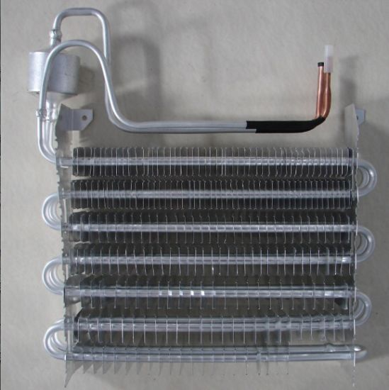
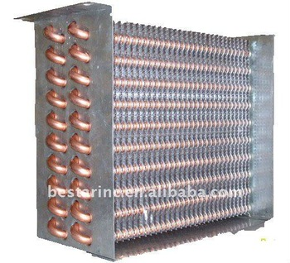
Evaporator

Slide 23
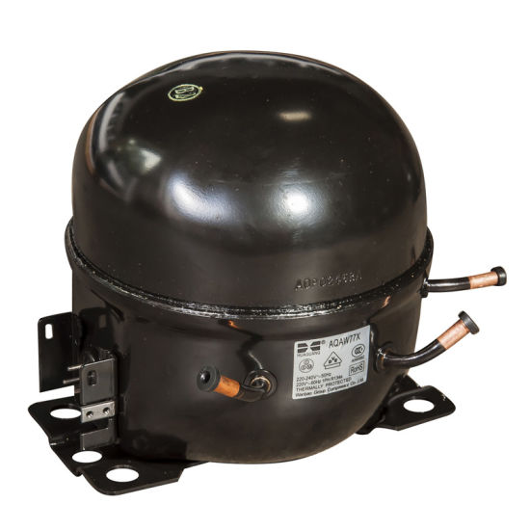
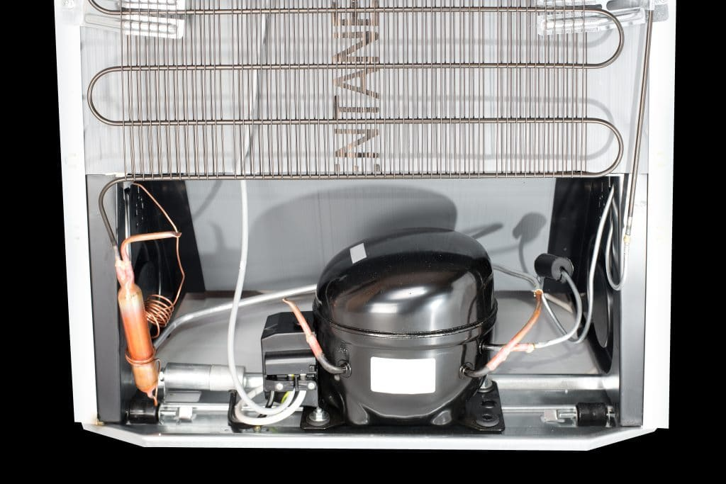
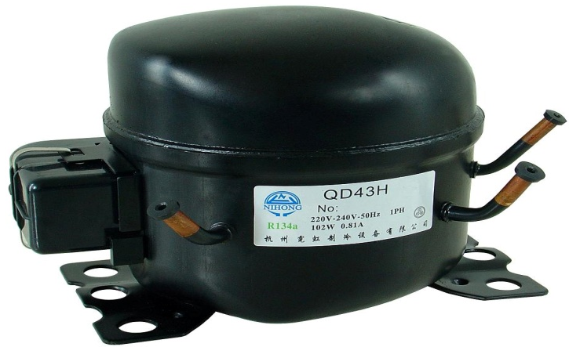
Compressor

Slide 24
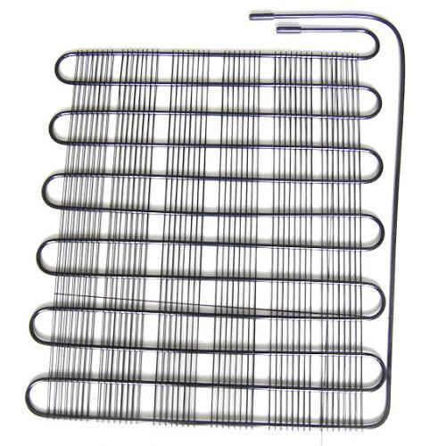
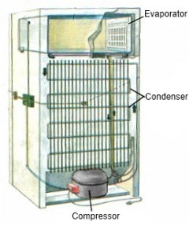
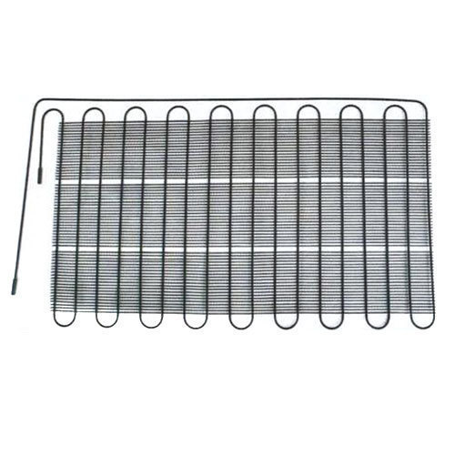
Condenser

Slide 25
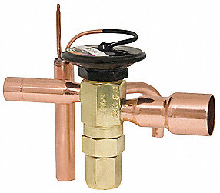
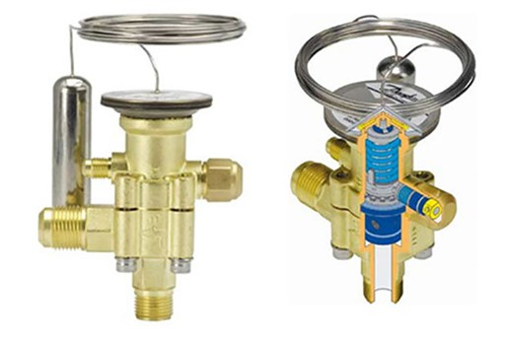
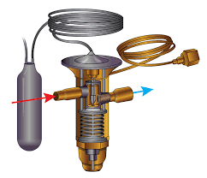
Expansion Device

Slide 26
Refrigerants commonly used in practice
Ammonia | In vapour absorption refrigerators.
Carbon-dioxide | In marine refrigerators.
Sulphur dioxide | In household refrigerators.
Methyl chloride | In small scale refrigeration and domestic refrigerators.
Freon-12 | In domestic vapour compression refrigerators.
Freon-22 | In Air-conditioners.

Slide 27
Properties of a Good Refrigerant:
Thermodynamic Properties
Physical
Properties
Safe Working Properties
Other
Properties
Boiling Point.
Freezing Point
Evaporator and condenser Pressure.
Latent heat of evaporation.
Specific Volume.
Specific Heat.
Viscosity.
Toxicity.
Flammability.
Corrosiveness.
Chemical Stability.
COP.
Odour.
Leak.
Action with lubricating oil.

Slide 28
Thermodynamic Properties
Boiling Point:
An ideal refrigerant must have “low boiling temperature” at atmospheric pressure.
Freezing Point:
Must have a very “low freezing point” because, the refrigerant should not freeze at low evaporator temperatures.

Slide 29
Thermodynamic Properties
Evaporator & Condenser Pressure:
Pressures in both should be slightly above atm. Pressure, in order to avoid the leakage of atm. air and also to enable the detection of the leakage of the refrigerant.
Latent heat of Evaporation:
Latent heat of Evaporation must be very high, so that a minimum amount of refrigerant will accomplish the desired result.

Slide 30
Physical Properties
Specific Volume:
It is the ratio of Volume of the fluid/Mass of the fluid, in m³/kg.
Specific volume of the refrigerant must be very low.
It will reduce the size of the compressor.
Viscosity:
Viscosity of a refrigerant at both the liquid & vapour states must be very low as it improves the heat transfer and reduces the pumping pressure.

Slide 31
Safe working Properties
Toxicity:
Refrigerant must be non-toxic, because any leakage, increases suffocation & poisons the atmosphere.
Corrosiveness:
Refrigerant should be non-corrosive, to prevent the corrosion of the metallic parts of the Refrigerator.
Chemical stability:
Refrigerant must not decompose under operating conditions.

Slide 32
Other Properties
COP
COP of a Refrigerant must be high, so that the energy spent in refrigeration will be less.
Odour
Refrigerant must be odourless, otherwise some food stuff such as meat, butter etc. loses their taste.
Leakage Tests
Refrigerant must be such that any leakage can be detected by simple tests.
Action with lubricating oil
Refrigerant must not react with the lubricating oil, used in lubricating the parts of compressor.

Slide 33
Properties of a good Refrigerant
High latent heat of vaporization.
Low boiling and low freezing point.
Non-toxic and non-corrosiveness
Non-flammable and non-explosive.
High thermal conductivity
Easy to handle
Low specific volume of vapour.
High coefficient of performance

Slide 34
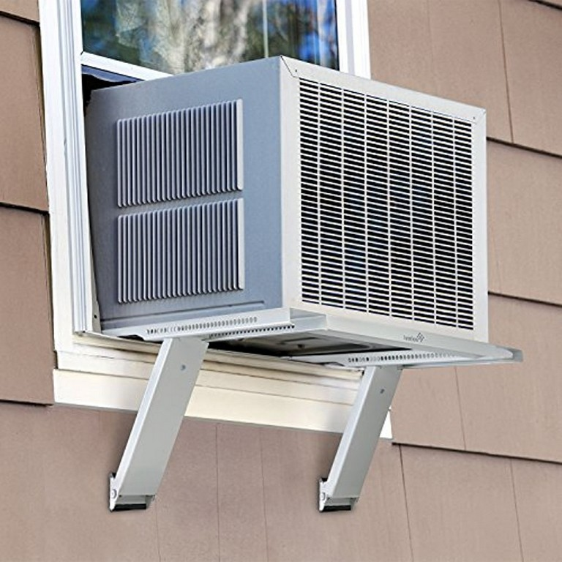
Air-Conditioning
Major components:
Evaporator
Condenser
Compressor
Capillary tube
2 Fans – One for Evaporator & other for Condenser.
– Driven by a single motor.

Slide 35
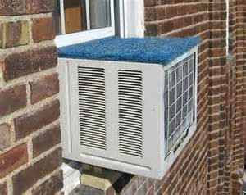
Air-Conditioning
Unit is generally mounted on window sill.
Evaporator unit is placed inside the room.
Condenser part projects outside.

Slide 36
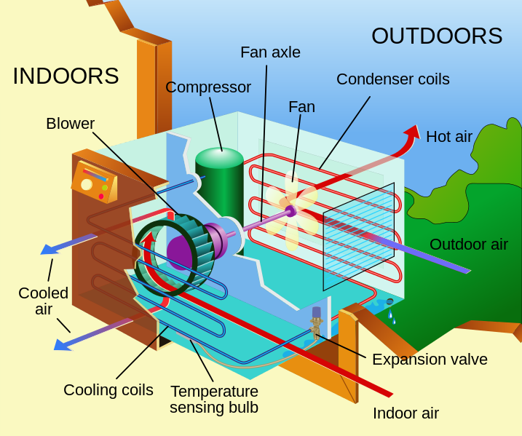
Air-Conditioning

Slide 37
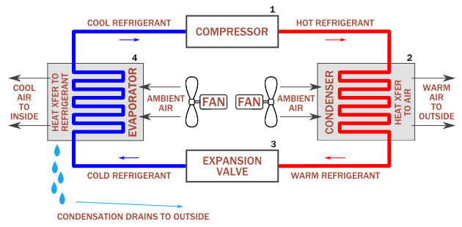
Air-Conditioning

Slide 38
Air-Conditioning
Evaporator Fan:
Draws the air (relatively at higher temperature) continuously from the space in the room, through air filter.
Forces this air to pass over the Evaporator.

Slide 39
Air-Conditioning
Evaporator:
Refrigerant absorbs the heat from air & evaporates.
Air gets cooled.
High temperature & low pressure refrigerant is drawn by the Compressor.

Slide 40
Air-Conditioning
Compressor:
Evaporated refrigerant with high temperature is drawn by the suction end of the compressor.
Compresses the refrigerant and delivers to the Condenser with high pressure.
High temperature & high pressure refrigerant enters the Condenser.

Slide 41
Air-Conditioning
Condenser Fan:
Draws atmospheric air from outside the room, and
Makes the air to flow over the Condenser.

Slide 42
Air-Conditioning
Condenser:
High pressure and high temperature refrigerant vapour flows through this.
Gives off heat to atmospheric air.
Temperature of the refrigerant is lowered.

Slide 43
Air-Conditioning
Capillary tube:
Cooled (low temperature), high pressure refrigerant from Condenser, passes through the capillary tube.
Undergoes expansion, lowering the pressure of the refrigerant.
Low pressure & low temperature refrigerant is made to flow through Evaporator.
Cycle repeats.

Slide 44
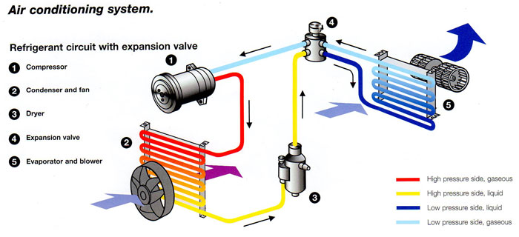

Slide 45


